Slide 1
High Temperature Testing in Flow Loop
Jessica Meisinger-MacDonald
University of New Haven
EL Fire Research Division – Fire Fighting Technology Group
Advisors: Dan Madrzykowski and Michelle Donnelly
August 4, 2015

Slide 2
Why are we doing this research?
Notes:
Firefighter Technology Group
Working with active working firefighters, tools, gear, and techniques to more efficiently:
Extinguish fires
Keep firefighters safer
Help entrapped have better chance of survival

Slide 3
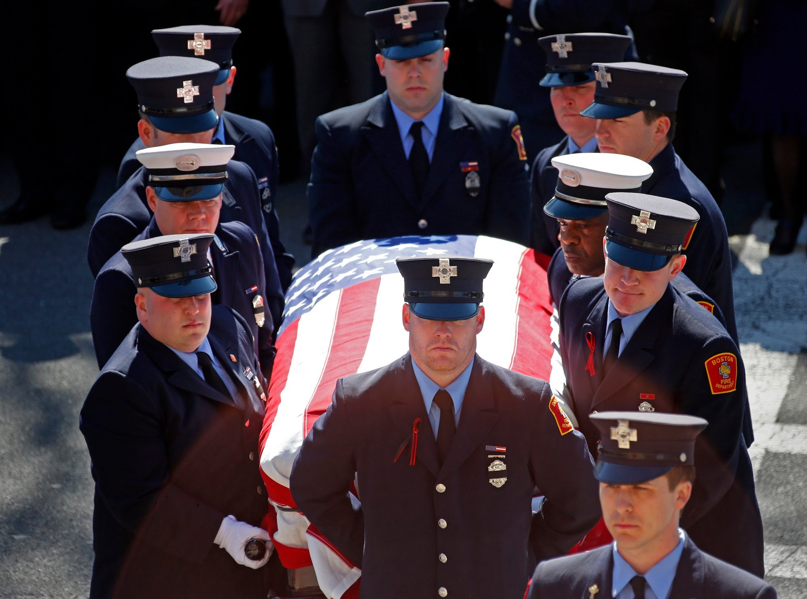
https://www.youtube.com/watch?v=tvi4SHqR2Gc
http://www.legacy.com/obituaries/bostonglobe/obituary.aspx?pid=170409832
Funeral for Boston Firefighter Michael R. Kennedy
BFD Ladder 15
Fighting a 9 alarm fire with engine 33 in bostons Back Bay
March 26, 2014
Died at age 33
Served 6 ½ years in USMC, Sgt., Combat Veteran of Operation Iraqi Freedom
Notes:
Do research to prevent FF LODD’s
Understand capabilities of equipment and help make standards for adequate equipment
Understand limitations of FF turnout gear and properties of gear to better know situations FF’s should be entering
Understand fire, ventilation, fire flow, fire patterns and best practices for safe extinguishment
Conservation of life and property will as little risk to responders as possible
This year there have been 49 firefighter fatalities ALREADY
Picture: http://www.legacy.com/obituaries/bostonglobe/obituary.aspx?pid=170409832

Slide 4
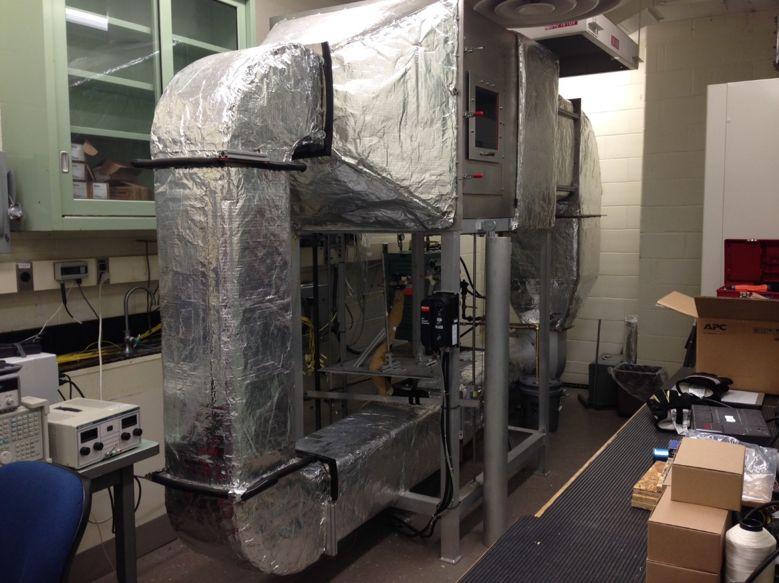
Flow Loop
Stainless steel loop with 60 Hz blower and heater
Maximum temperature 500°C
Inside flow loop:
Thermocouples
Bi-directional probes
Flux gauges

Slide 5
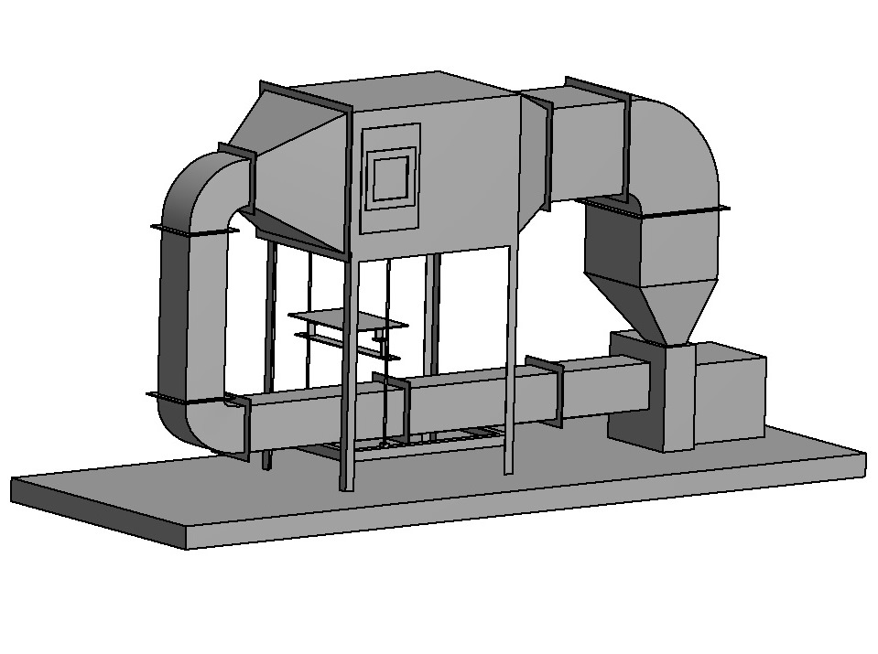
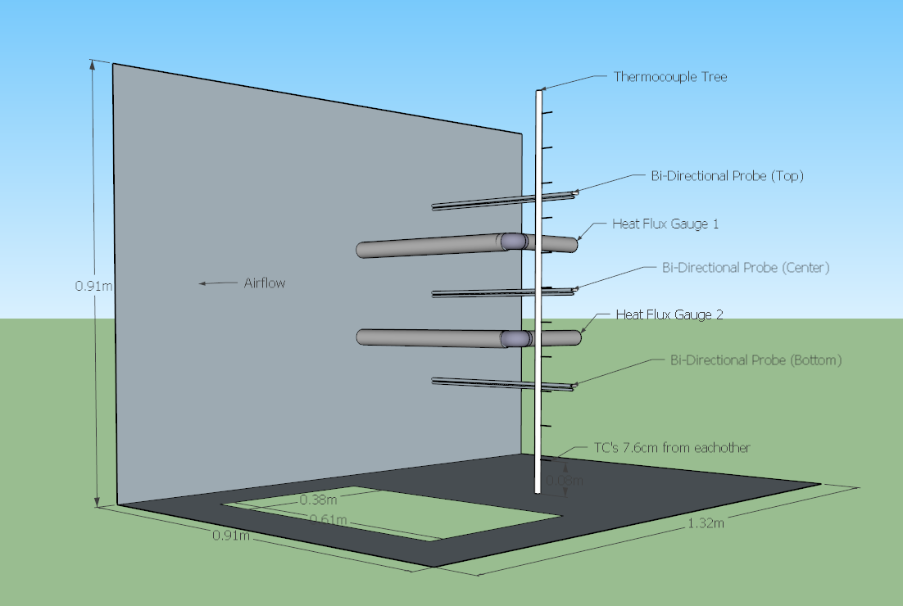
Equipment
Notes:
Thermocouples- 11 on TC tree, thermocouples show the temperature for that localized area.
6 additional TC channels available to place on or near what we are testing (16-21)
3 Bi-directional probes measures velocity of flow in loop
2 Flux gauges which measure heat flux

Slide 6
Flow Loop
Testing:
Gear Testing
Single sample with wood backing
Back to back samples
Helmet Testing
1010
880
Leather
Radio Testing
Remote Speaker Microphones (RSMs)
3RSMs

Slide 7
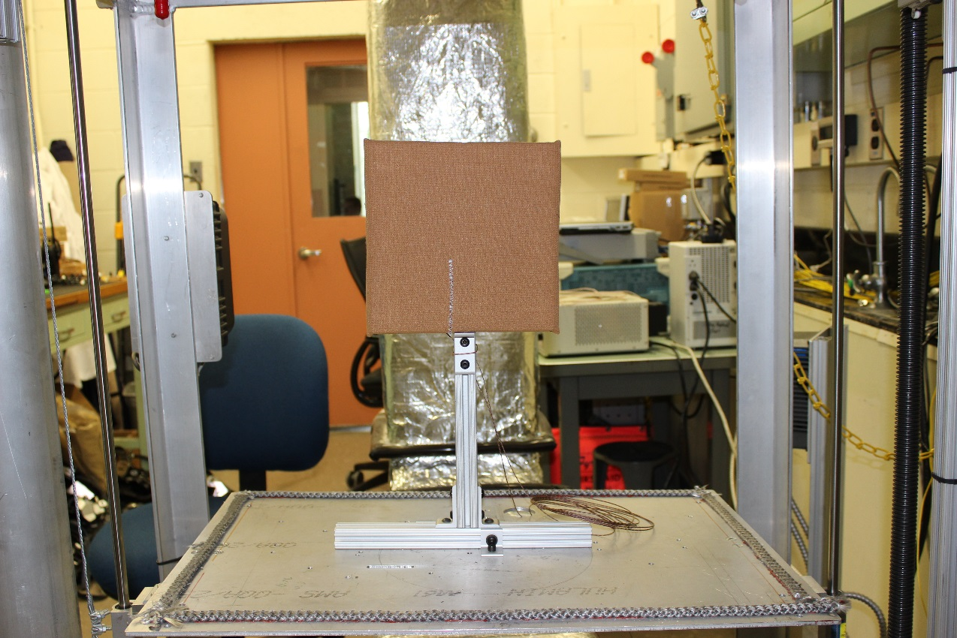
Gear Testing
Gear Samples:
A1, A2, A3
B1, B2, B3
Testing Setups
Gear on wood backing
Back to back gear tests
Notes:
Gear tests were done at 70, 100, & 200C
70C test were for 20 mins
100 & 200 C tests were done until the inside temperature reached 70C
At 70C FF will sustain major burns

Slide 8

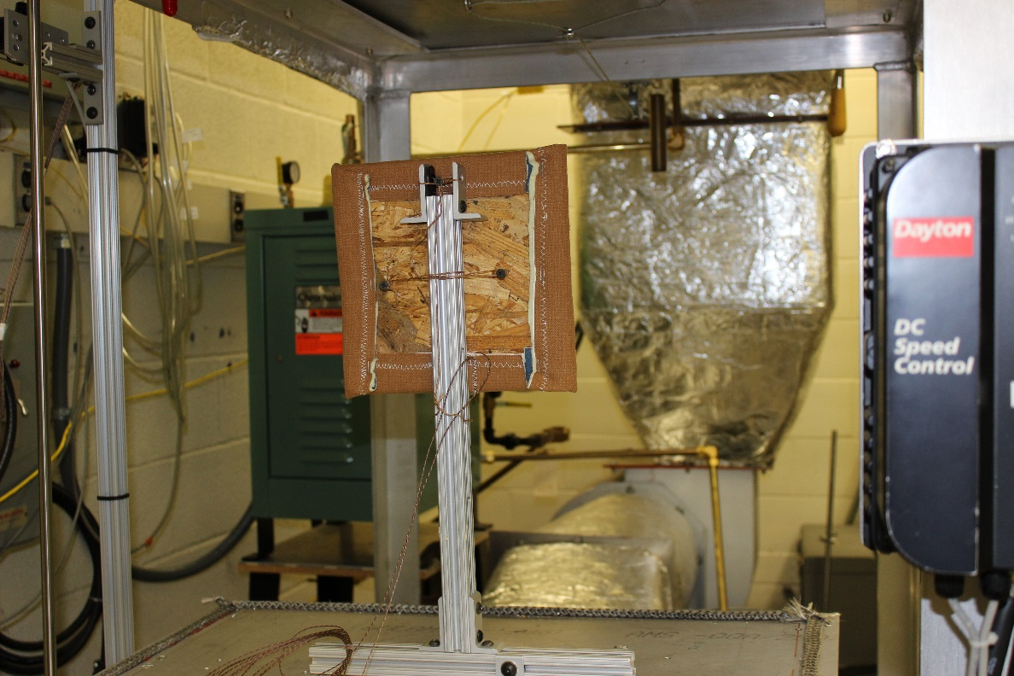
Gear Testing
Gear with wood backing
Notes:
2 TC’s
Front of sample
Between gear sample and wood, touching gear

Slide 9
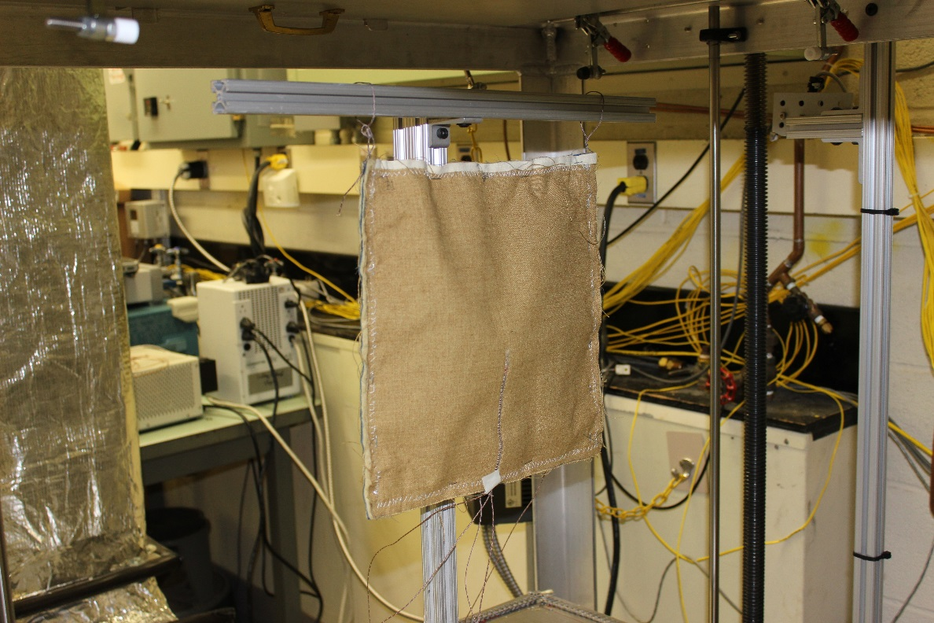
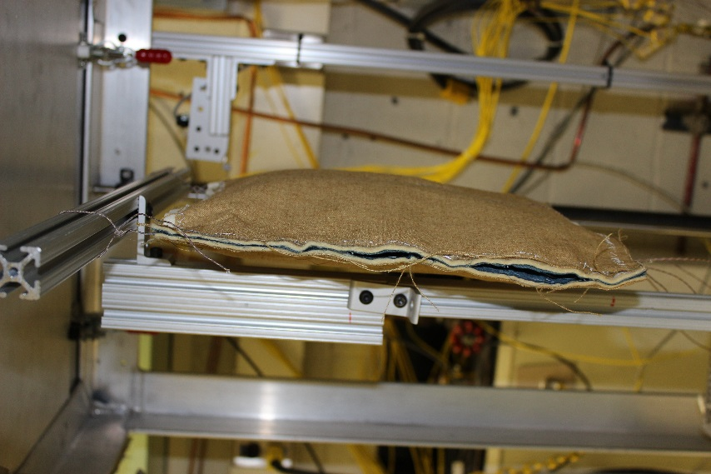
Gear Testing
Back to back gear testing
Notes:
4 TC’s
Two outside
Two inside
One in between two layers of gear samples (some test was ambient temp)
Optional 5th thermo couple to measure air in between two gear samples

Slide 10
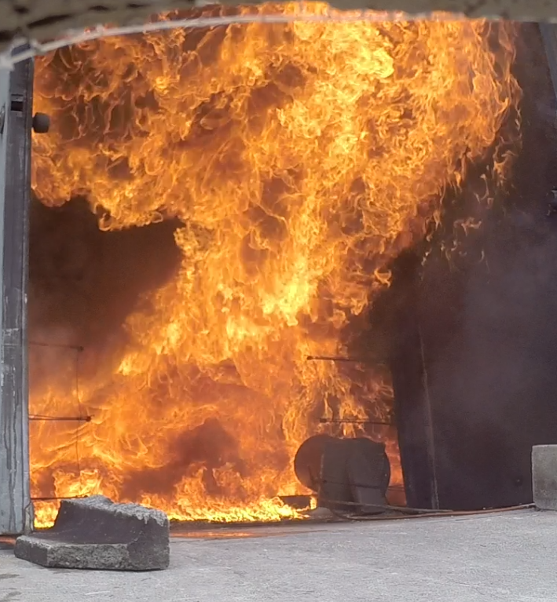
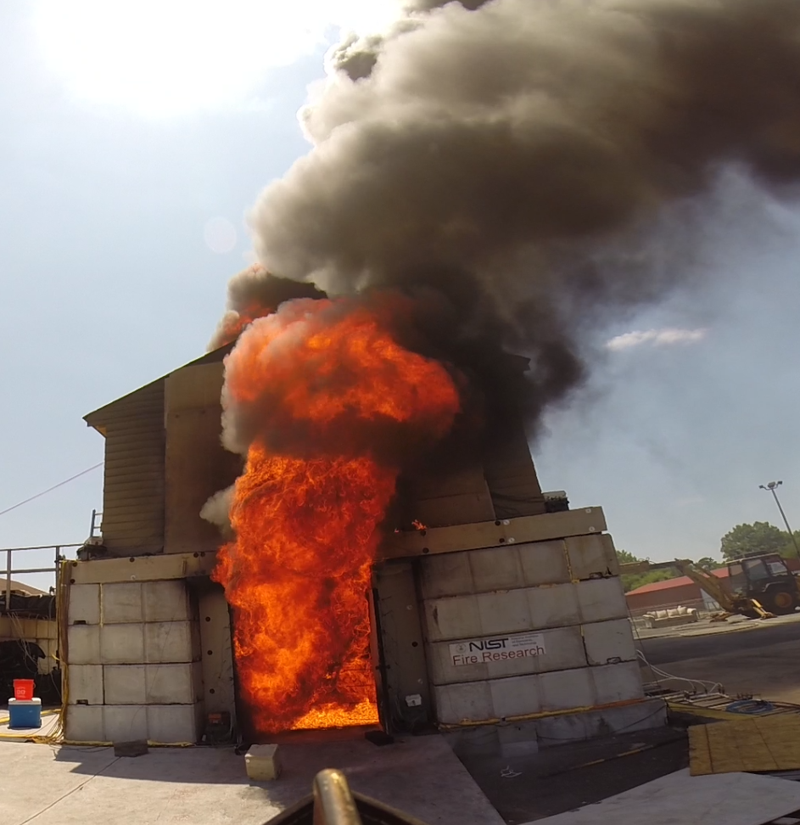
What’s Next for Data
Data comparisons to live fire testing
Notes:
This week and next week live testing will be continuing at Delaware County Emergency Training Center and radios have been sent up to see how they will handle live fire tests
Results can be compared to lab testing results to see if temperatures are similar.
If similar show that flow loop environment is good indication of what the sample will see live fire conditions
Use flow loop to easily create environment that can be repeated
Manufacturers have to do multiple tests so they need a standard created for an environment like a flow loop or convection oven that can be easily repeat for testing. Doing multiple live fires a day is unrealistic

Slide 11
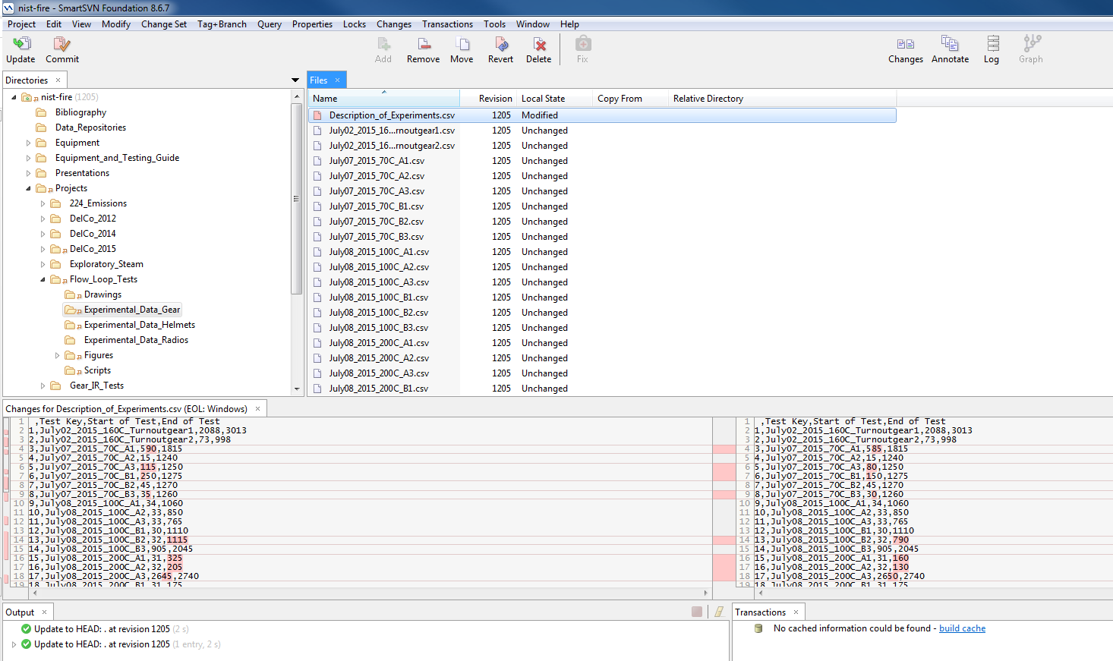
Data
Repository
Notes:
Convert files to .csv using excel
Upload files to repository
Update ‘Description of Experiments’ file

Slide 12
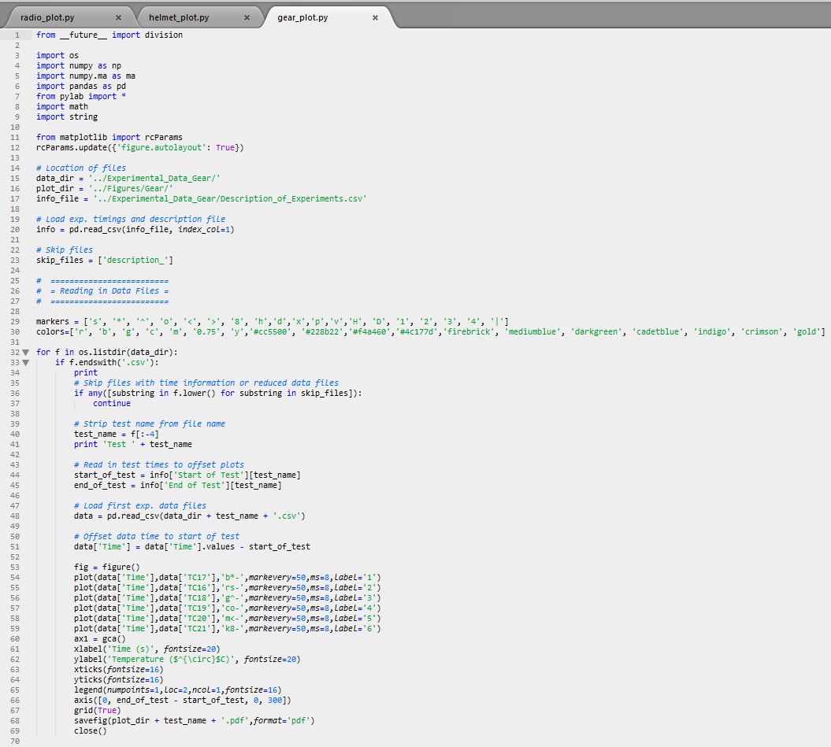
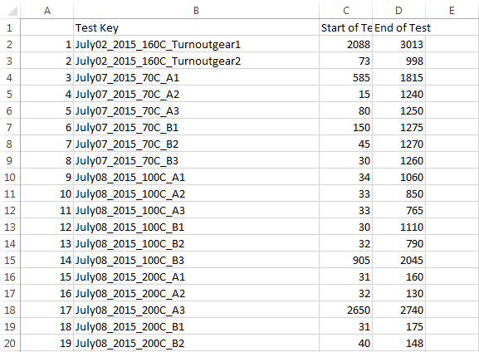
Data
Scripts
Notes:
Scripts use file for each folder titled “Description of Experiments” to find each experiment data file, find the start and stop time, and graph according to times indicated on script
Edit time sheet to show proper data points on graphs
Only use time of data you want to show

Slide 13
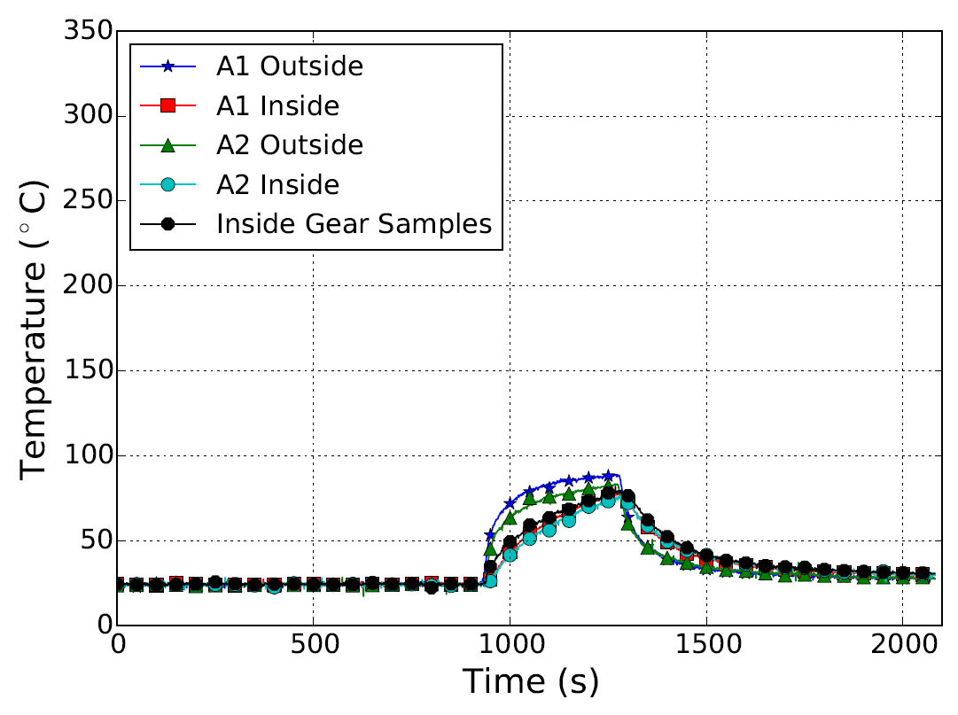
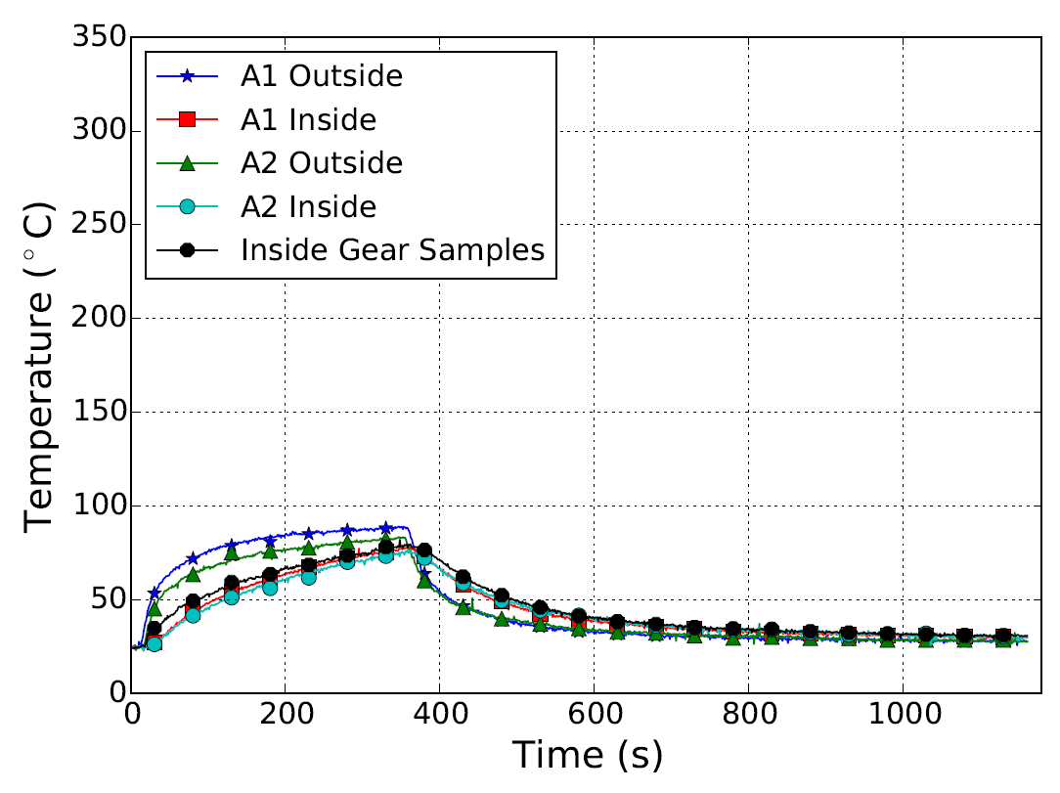
Data
July17_2015_100C_test3_A1A2
Notes:
Left:
Before editing ‘Description of Experiments’ for start times
Right:
Post editing of times
label editing in script
‘5’ was removed because TC was not used
Graph shows heat up of back-to-back ‘poofed’ material at 100C until inside heated to 70C then cool down
With this we can:
Data can be quickly analyzed
All uniformed charts if needed for reports or papers
Still able to alter files to tailor specific requirements for tests
Scripts written for gear, radios, and helmets so all data can be used and analyzed as needed

Slide 14
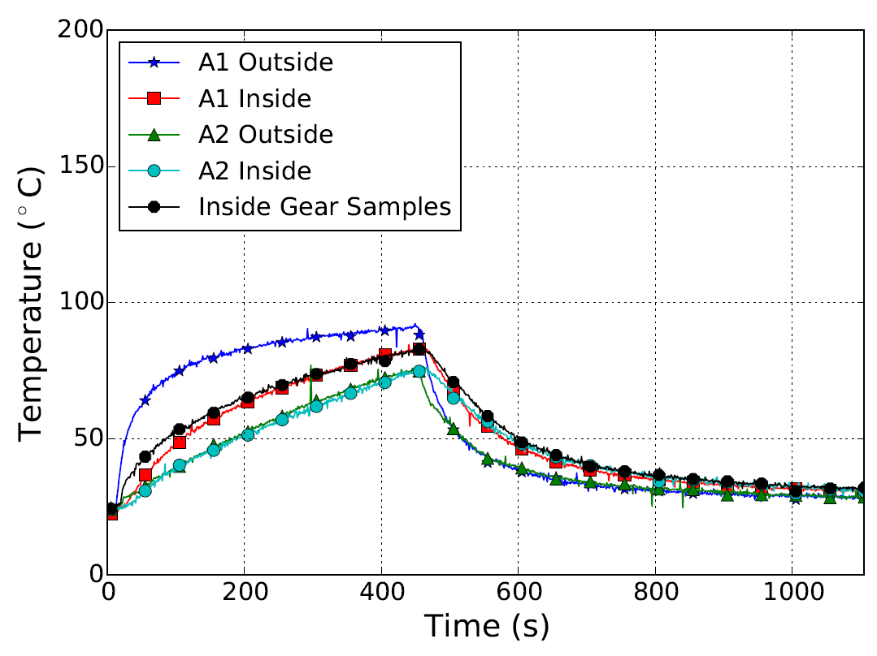
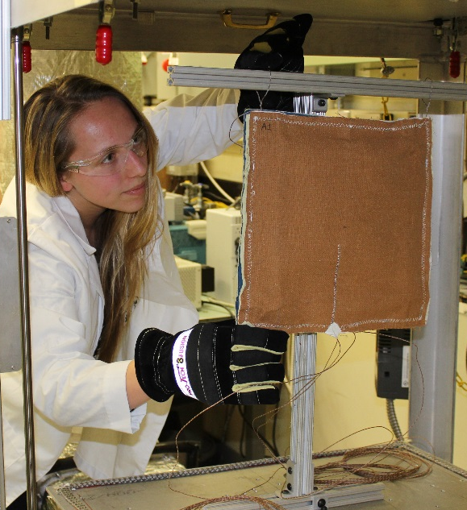
Gear Testing
Gear sample A1 and A2
100°C testing
Keep sample in flow loop until inside temperature reaches 70°C
Monitor cool down until below 35°C
Notes:
Graph shows stored energy in turnout gear after being removed from heat
As it cools down the interior temperatures stay higher and the outer temperatures cool faster then the inside temperatures.

Slide 15
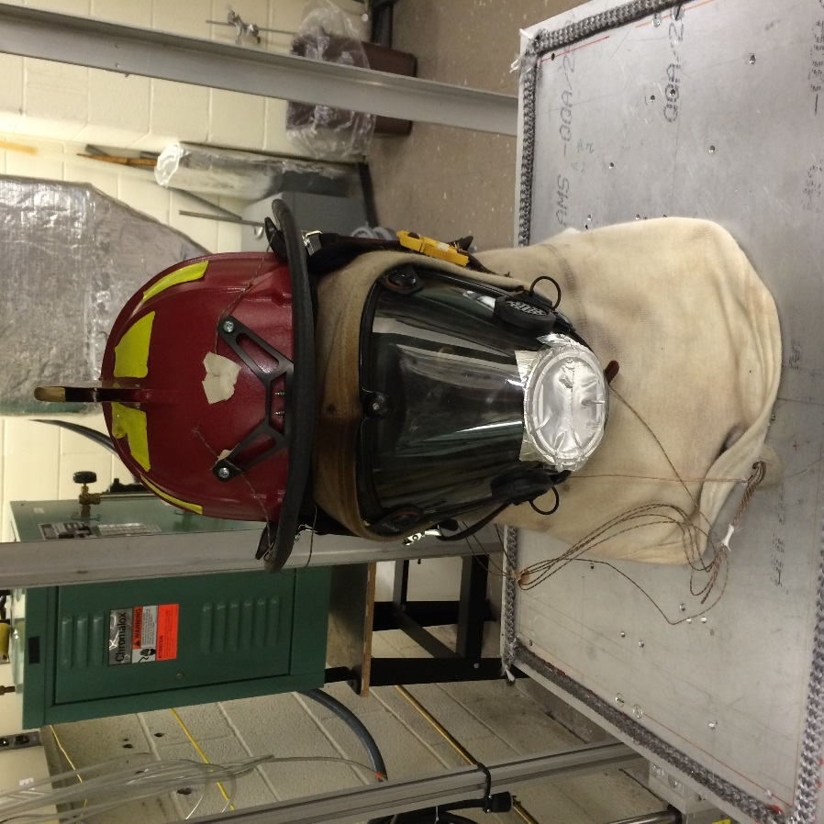
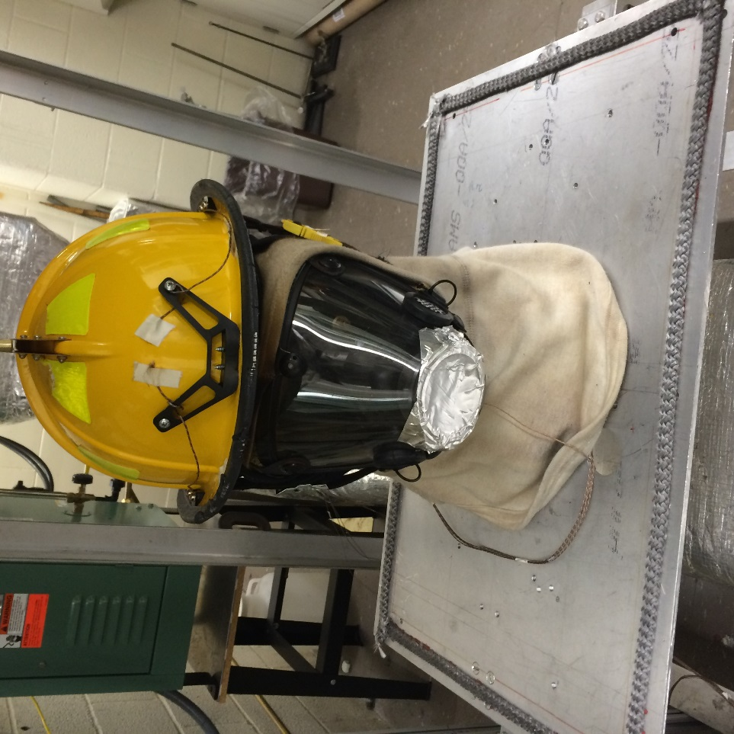
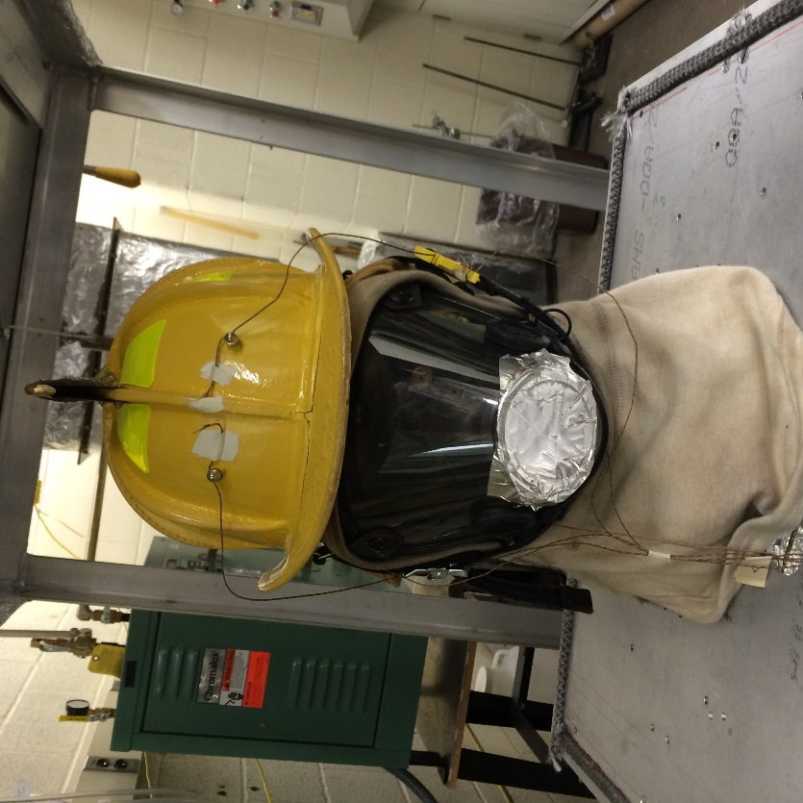
Helmet Testing
Tests on 880, 1010, and leather helmets
Notes:
Helmet testing was done on 880, 1010, and leather helmets
Testing done at 160C for 15 minutes and 260C for 5 minutes
All helmets survived with little to no visible damage from testing
Testing data can be used to compare with data from field testing of helmets

Slide 16
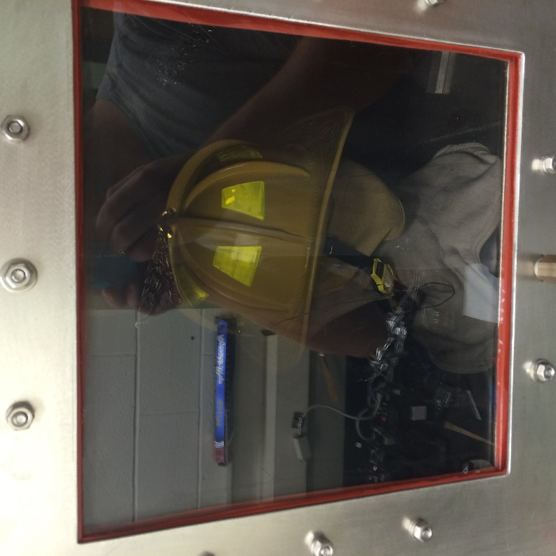
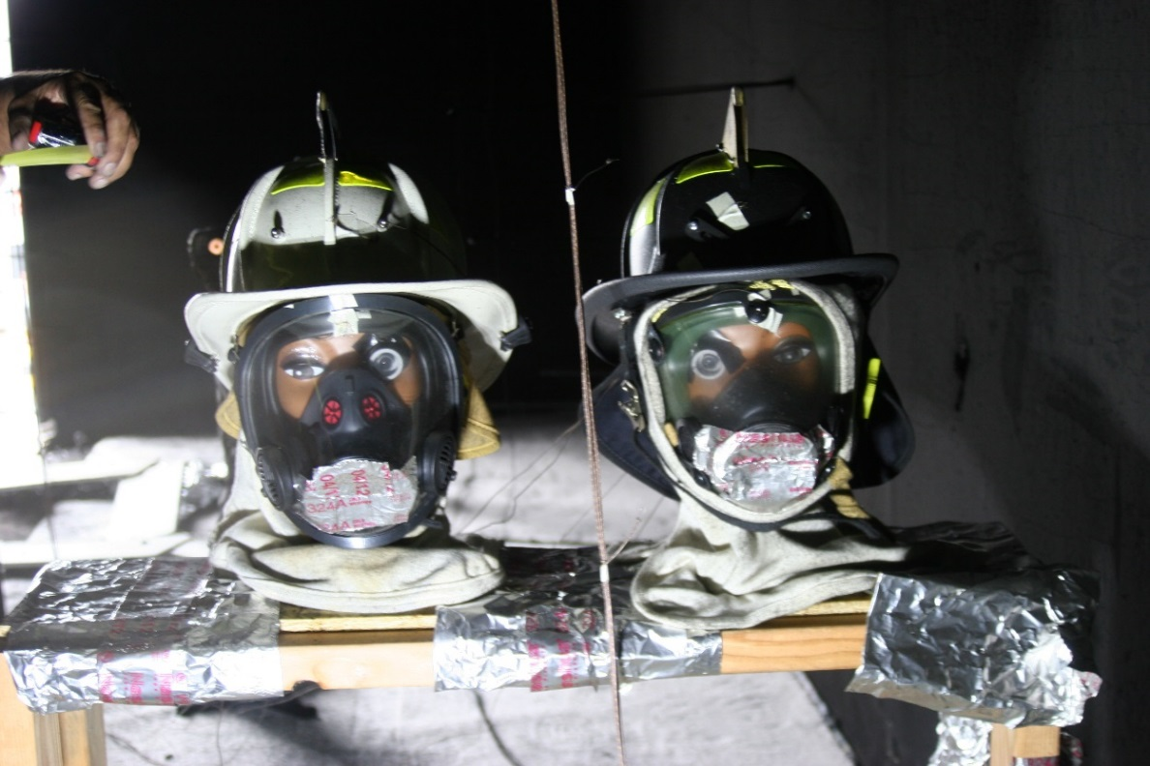
Helmet Testing
Notes:
Left: Helmet testing set up for lab, leather in flow loop
Right: Helmet testing set up for field tests at Delco (left leather, right 880)

Slide 17
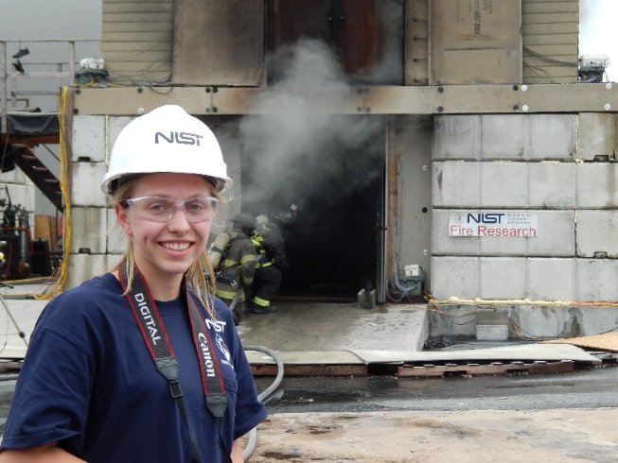
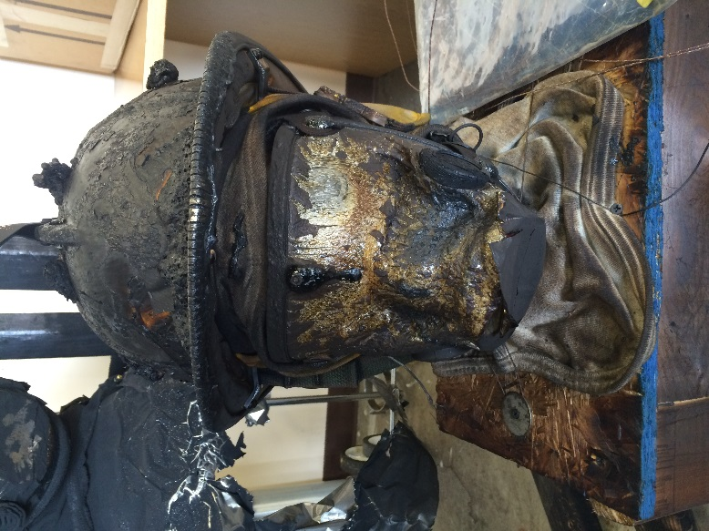
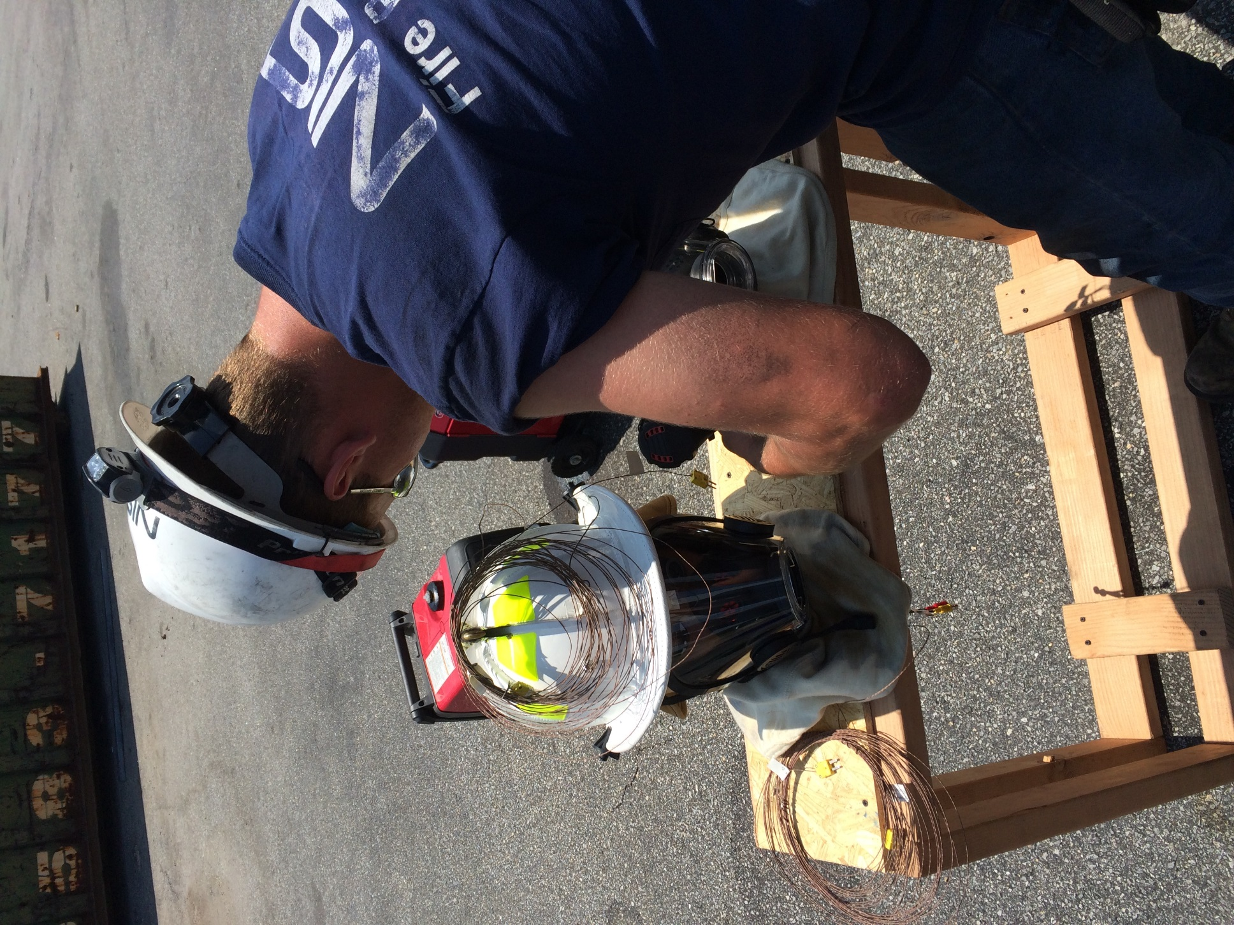
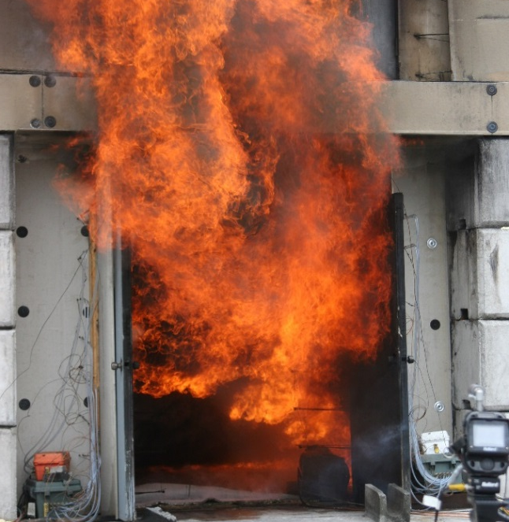
Alternative Testing Comparisons
Live fire testing done at Delaware County Fire Training Facility
Notes:
Live, full scale testing at DelCo

Slide 18
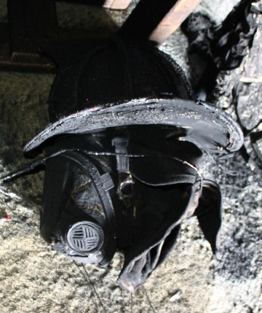
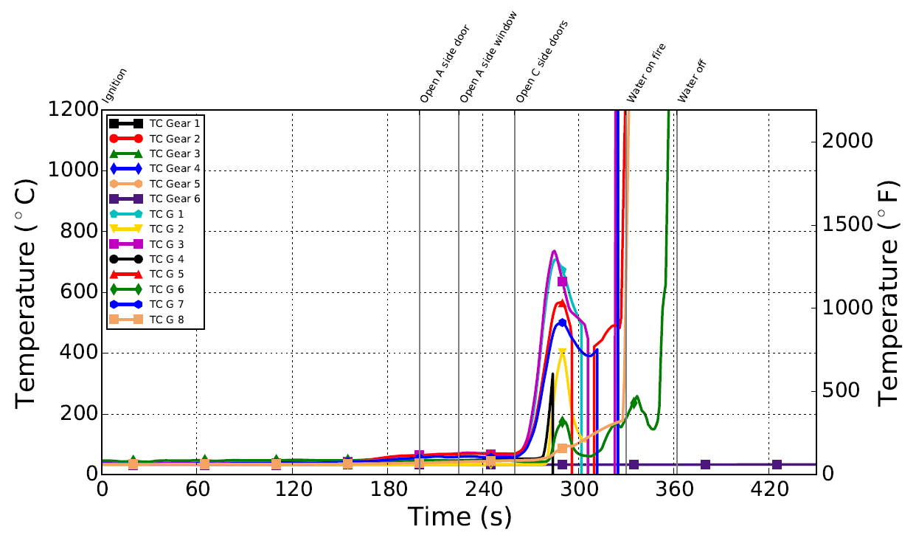
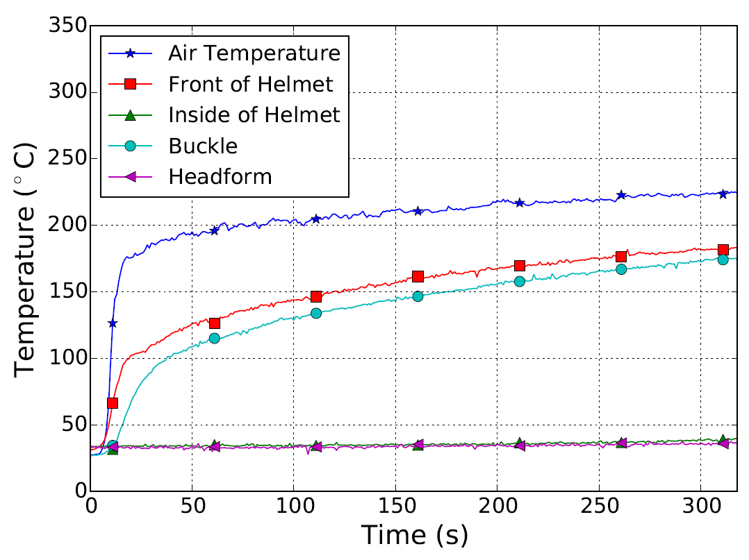
Helmet Testing
Lab Test
Field Test
Notes:
Field test data:
TC Gear NOT USED
TC G1 Right Helmet Outside (Light Blue)
TC G2 Right Helmet Inside (Yellow)
TC G3 Right Mask Outside
TC G4 Right Mask Inside
TC G5 Left Helmet Outside (Red)
TC G6 Left Helmet Inside (Green)
TC G7 Left Mask Outside
TC G8 Left Mask Inside
If test results are similar can use flow loop as accurate representation of live fire condition for testing and set standards from that.

Slide 19
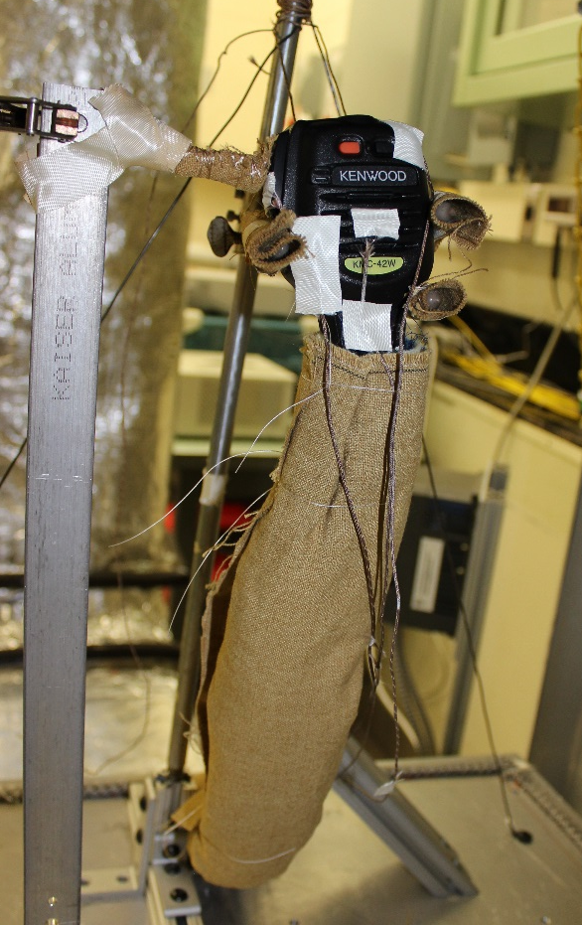
Radio Testing
Create standards that will have the gear outlast the users of the gear
2006 Portable Radios Testing Begins at NIST
PASS, SCBA, TIC Testing
2014 Portable Radio Cords Testing
2015 Portable Radio Speaker Microphone Testing
Notes:
If there is a fail it will not be because the technology failed under heat, will be because conditions failed firefighter.

Slide 20
Radio Testing
Existing Standards:
NFPA122 8.3.5.4: “Mobile radios and associated equipment shall be manufactured for the environment in which they are to be used”
NFPA1121 8.3.6.2: “Portable radios shall be manufactured for the environment in which they are to be used and shall be the size and construction to allow their operation with one hand”

Slide 21
Radio Testing
Thermal Class | Time Duration | Temperature
Class I | 25 min | 100°C (212°F)
Class II | 15 min | 160°C (320°F)
Class III | 5 min | 260°C (500°F)
Class IV | < 1 min | >260°C (>500°F)
Notes:
Thermal classes established for electronic equipment in firefighting, not gear, helmets, etc.

Slide 22
Radio Testing
Results
RSM |  | Thermal Class I | Thermal Class II | Thermal Class III
R | R1 | P | P | P
 | R2 | P | P | -
 | R3 | P | P | -
W | W1 | P | P | N/A
 | W2 | N/A | N/A | F (120-180 sec)
P | P1 | P | P | P
 | P2 | P | P | P
 | P3 | P | P | -
Notes:
Current radio tests for this summer, only one model of radio failed, good news for firefighters
Note: W1 as not tested at class III due to button damage after class II, still functional but damaged slightly, W2 was then tested in class III to complete a full class test for the model

Slide 23
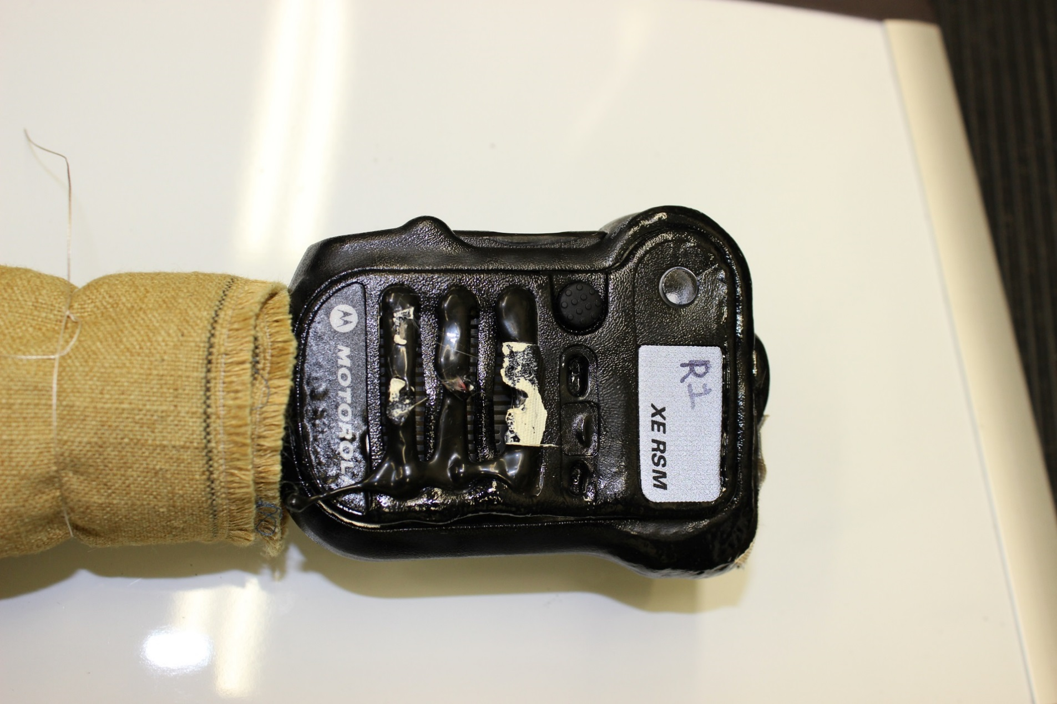
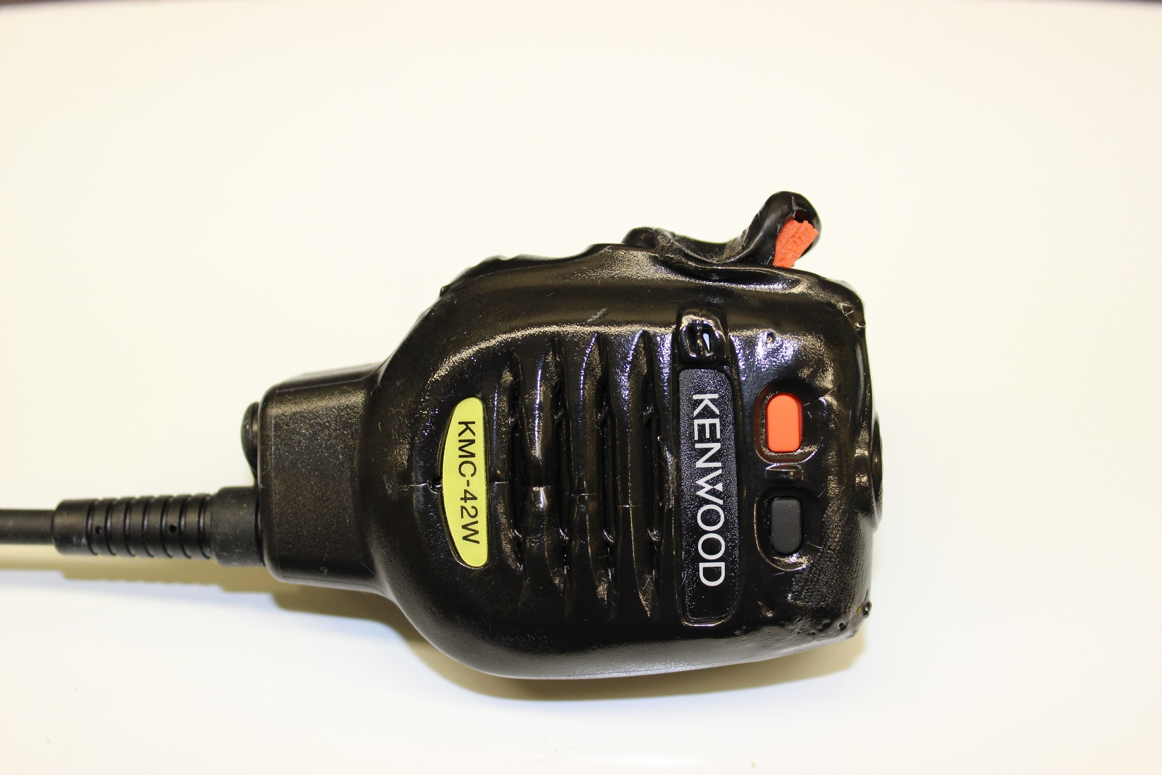
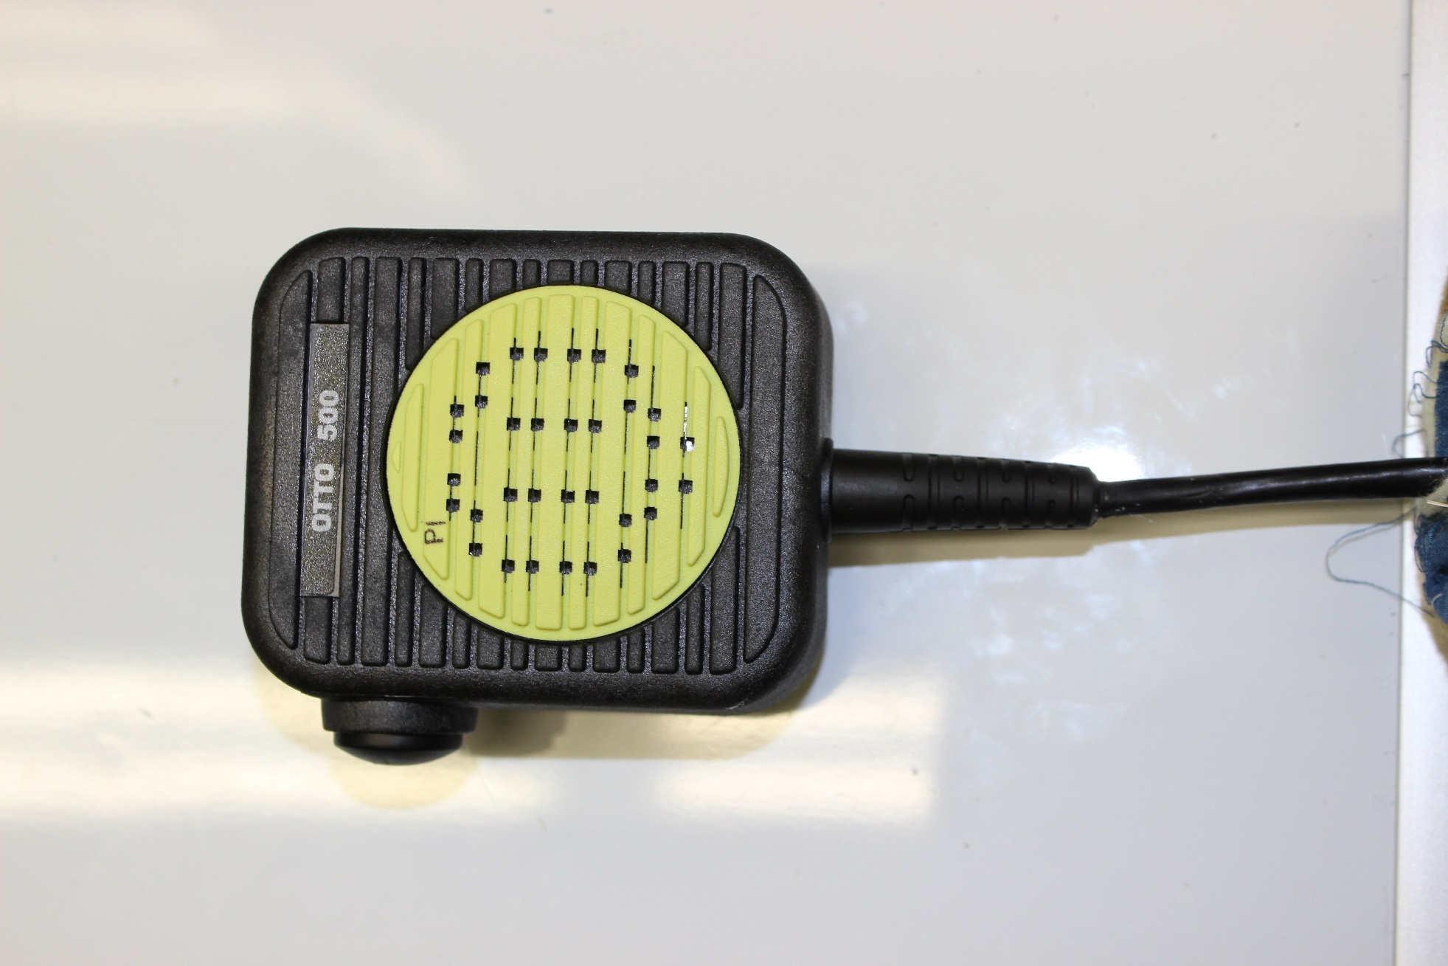
Radio Testing – Post Class III
Notes:
Pictures of all three radio models post thermal class III testing

Slide 24
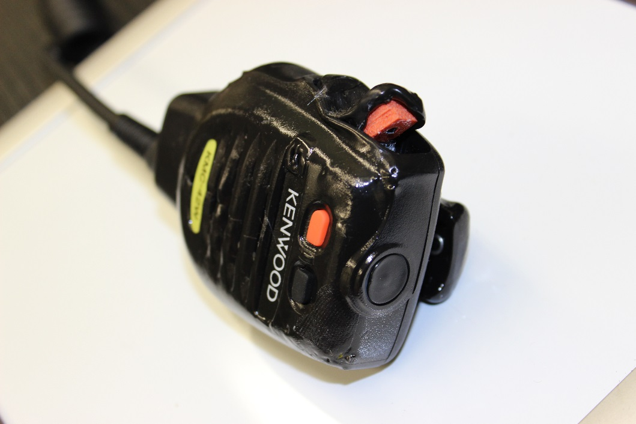
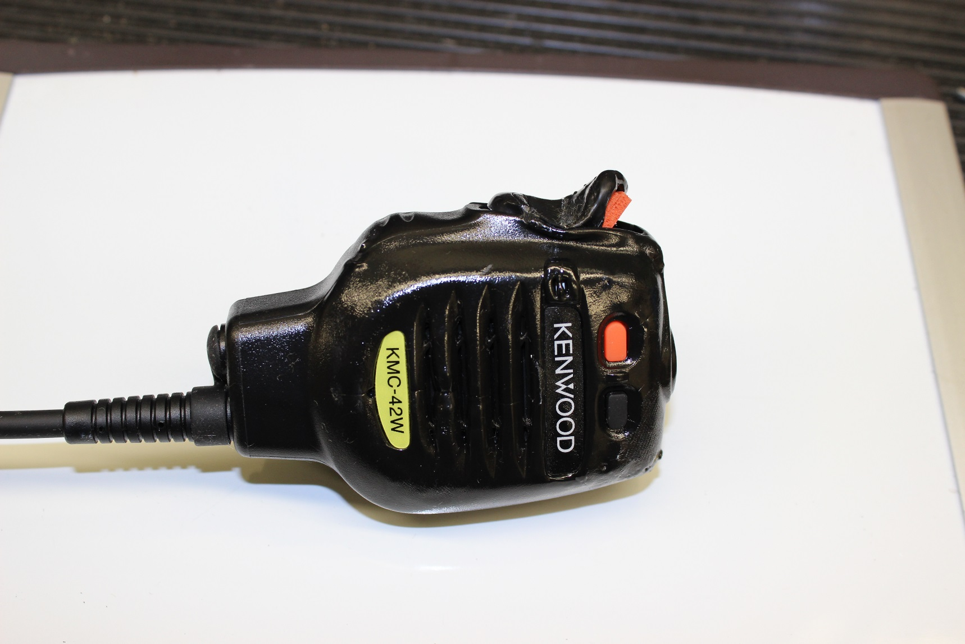
Radio Testing
Point of failure:
PTT button
Notes:
Point of failure was the PTT Button

Slide 25
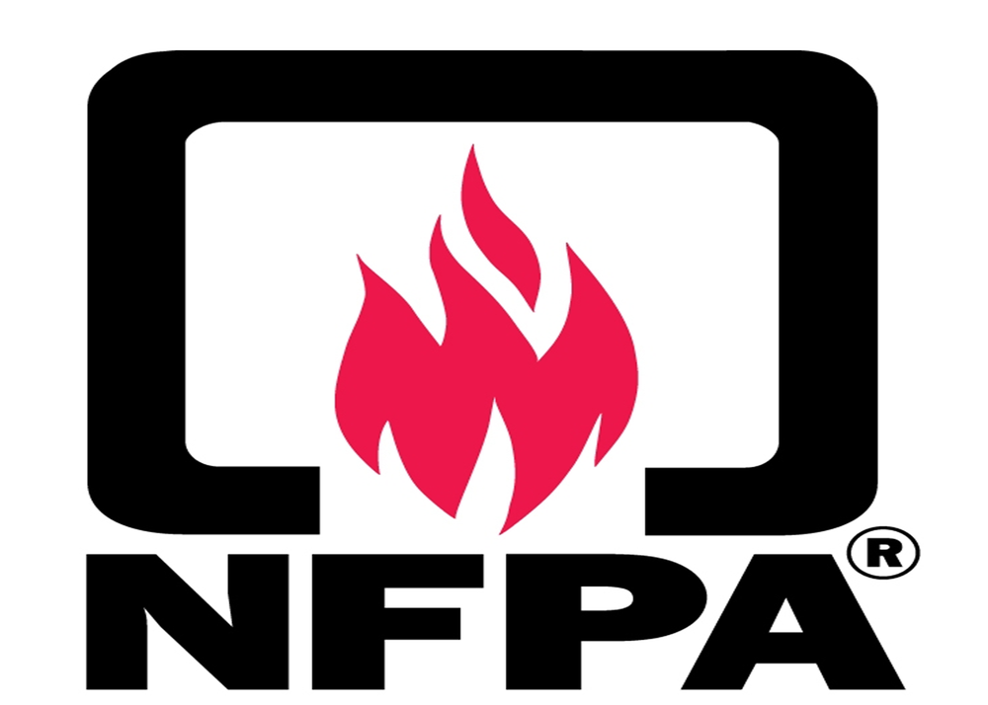
What’s Next?
http://www.ipu.co.uk/nfpa-20-national-fire-protection-association-safety-standard/
Notes:
The results of the tests put into report
Report will help NFPA (National Fire Protection Association) to develop standard for handheld radios

Slide 26
Questions?
Notes:
Thank you!

